Slide 1

Sentiment Analysis, Emotions and prediction of stock market
By,
Yousuf Minhaj,
Supervised by,
Muhammad Nouman Durrani
Notes:
To change the image on this slide, select the picture and delete it. Then click the Pictures icon in the placeholder to insert your own image.

Slide 2
Problem
In last ten years, stock prices or crypto currencies popularity have experienced tremendous global growth resulting in much higher trading prices more over this might be because of the reaction of the people over recent years on social media, news and RSS live feeds.
The distinctive nature of social media website makes it a valuable source for mining public views or emotions to predict the nature of money market.
Investors Doesn’t know where to invest.
Early this year in 2021 Elon Musk Chairman of a well know Organization just added a hash tag tweet of a crypto currency and his company the shares of both gone high, people doesn’t know when the change occurs

Slide 3
Key Requirements and Functionality
Fluctuation Analysis of Money Market Prices.
Analyzing and Processing Data using ML.
Better view and understanding for user.
Predictability for every stock with trends.
Predictability using Live Feeds Twitter Sentiments and News.
Evaluation and Validation of Predicted Results
Detailed Reporting

Slide 4
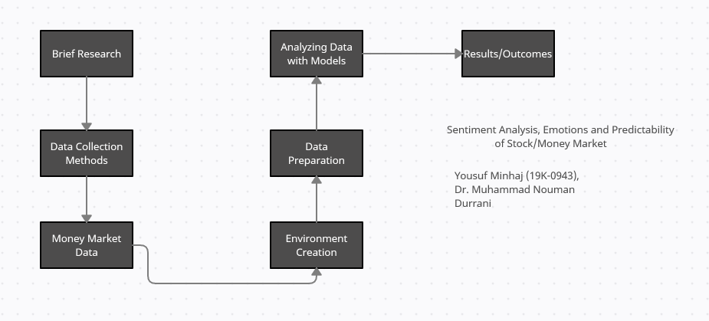
Block Diagram

Slide 5
Explanation
Data Collection:
Data will be collected from two data sources
YAHOO Finance API
Twitter Search API
Money Market Data:
YAHOO Finance API consist of the following Stock Values of Each Day:
Open
Close
High
Low
Twitter Search API
Tweet Id
Tweet Timestamp
Tweet Text

Slide 6
Explanation
Environment Creation:
Friendly Environment will be created for User which Includes the following:
A DashBoard (WebApp)
Python Runner & Python Engine
Languages:
C# (.Net Core)
Python
Jquery
Bootstrap

Slide 7
Explanation
Data Preparation:
Data PreProcessing:
Data Collected from YAHOO needs to be preprocessed to make it suitable.
But there is main problem that there is no data values are present in weekends and holiday or when market is closed.
To overcome the problem we use simple formula:
Y = (xPrevious + xNext)/2
We are using two metrices which are useful for machine learning algorithms
HLPCT(High Low Percentage)
HLPCT = High-low/low
PCTChange(Percentage Change)
PCTChange = Close-open/open

Slide 8
Explanation
Data Preparation (Cont):
Data PreProcessing:
Data Collected from Twitter needs to be preprocessed to make it suitable
User Request the API to get Tweets from the Server.
We use Twitter Api which is a REST Api the result will come in JSON format
The Search API allows filtering based on language, region, geolocation and time.
JSON objects that contain the tweets and their metadata.
A variety of information, including username, time, location, retweets, and more.
we use $ sign as a ticker to gather the most financial tweets.
used TweetPy which is a wrapper for the Twitter API

Slide 9
Explanation
Data Preparation (Cont):
Data PreProcessing:
Data Collected from Exchanges needs to be preprocessed to make it suitable
User Request the API to get data from the Server.
We use Api which is a REST Api the result will come in JSON format

Slide 10
Explanation
Data Preparation (Cont):
Sentiment Analysis:
Text Processing (will be done using NLTK for Python)
Tokenization
Removing Stop words
Twitter Symbols
Training Set
Positive sentiment query: ”:) :-) =) :D “
Negative sentiment query: ”:( =( hate dislike”
Training the classifier
Feature Extraction
Feature Filtering

Slide 11
Explanation
Analyzing Data With Models:
We will use machine learning techniques.
Long-Short Term Memory (LSTM) Model
Linear Regression
ARIMA Time Series Model
Model Evaluation
Accuracy
Round Mean Squared Error (RMSE)

Slide 12
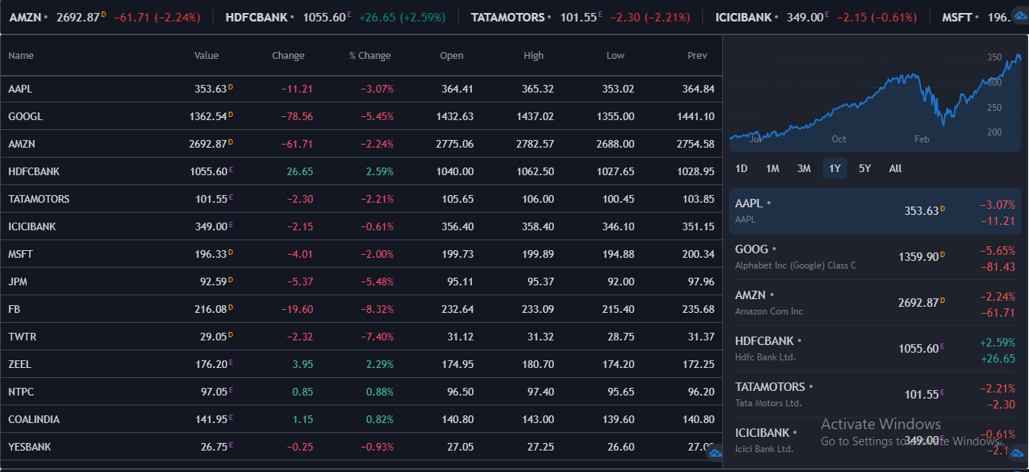
Explanation of Technical Analysis with Trends And User Interface
Top Ticker Trends

Slide 13
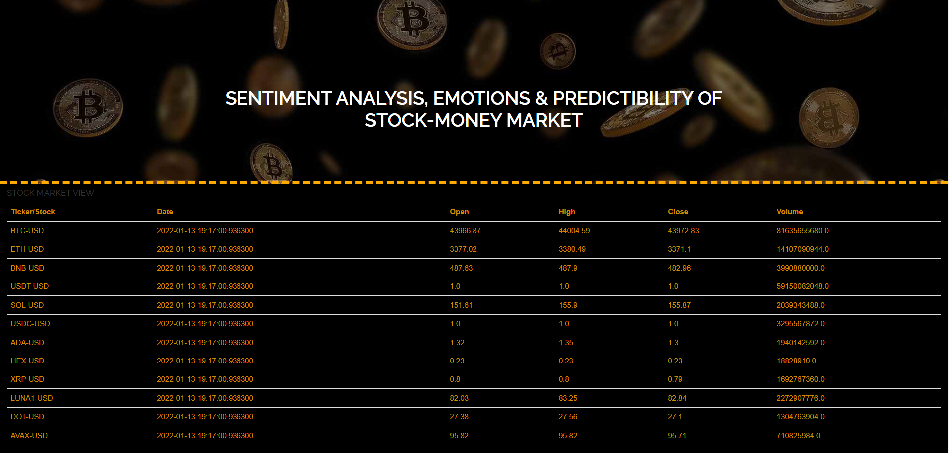
Explanation of Technical Analysis with Trends And User Interface
Top Ticker Trends

Slide 14
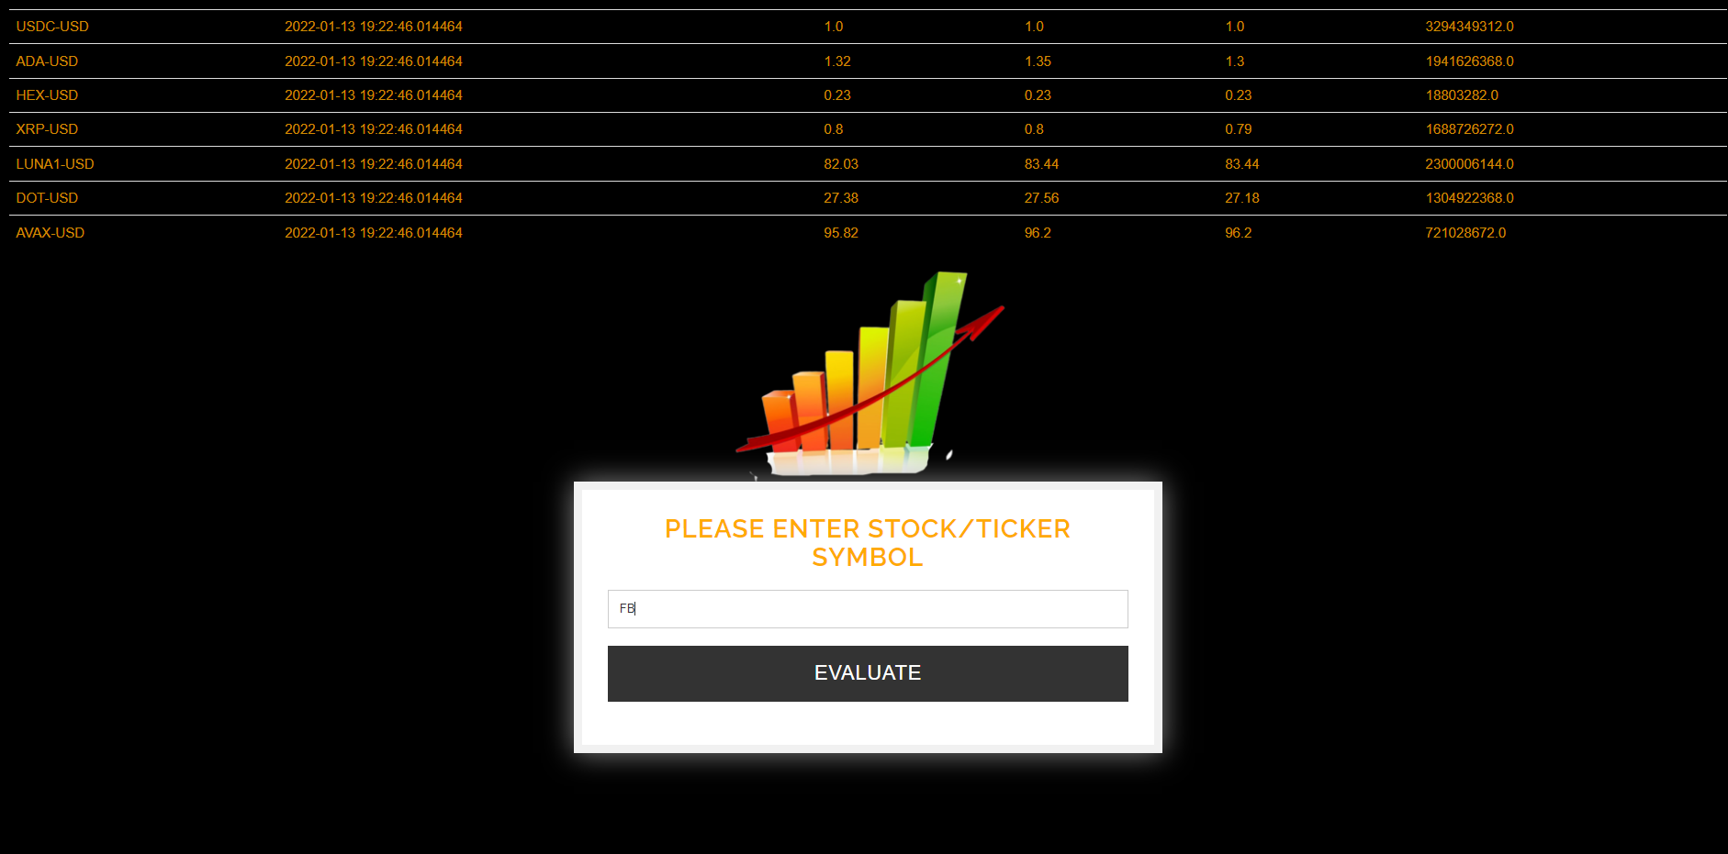
Explanation of Technical Analysis with Trends And User Interface
Ticker Evaluation Realtime

Slide 15
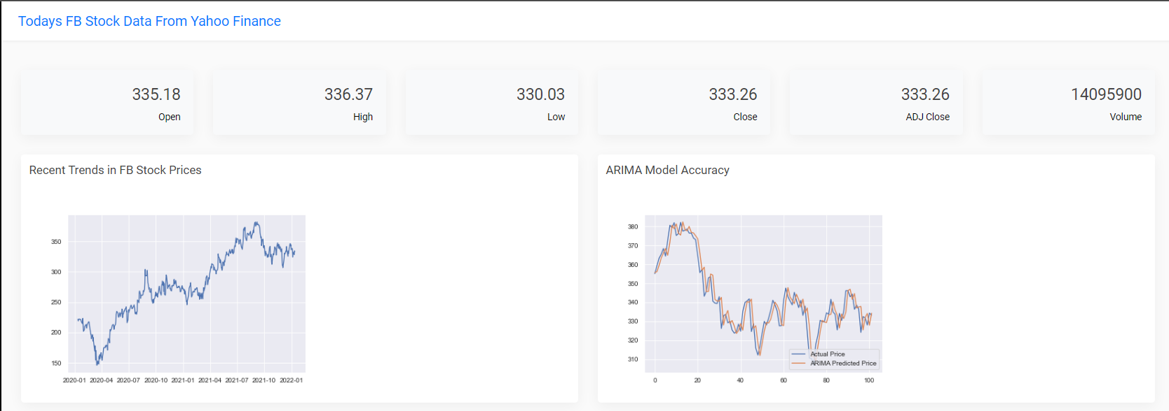
Explanation of Technical Analysis with Trends And User Interface
Ticker Evaluation Realtime

Slide 16
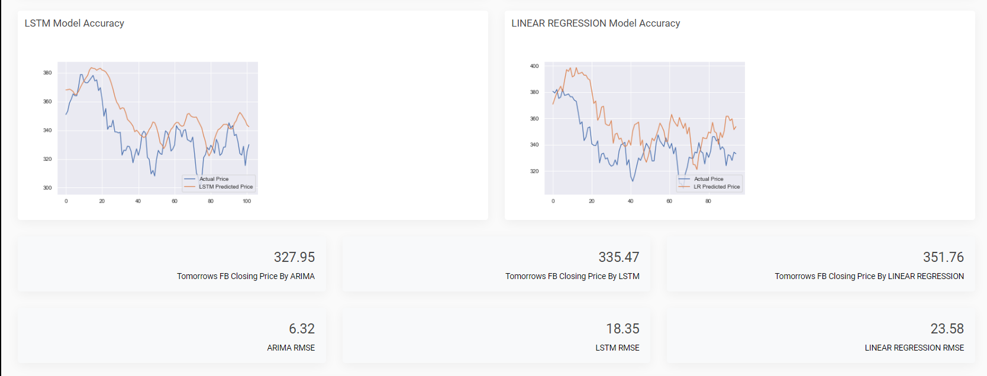
Explanation of Technical Analysis with Trends And User Interface
Ticker Evaluation Realtime

Slide 17
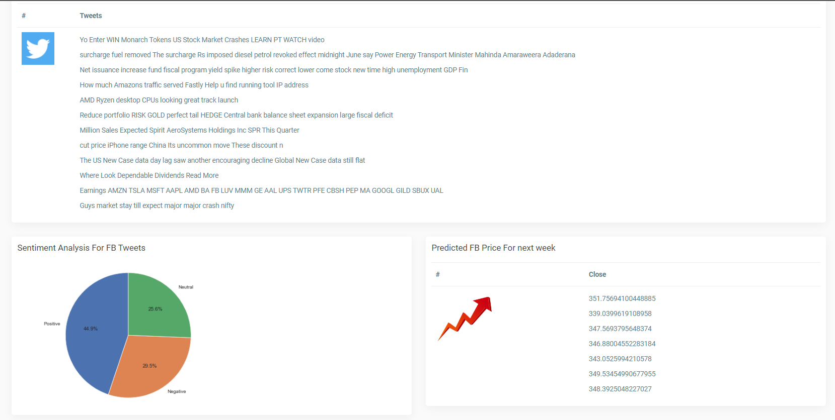
Explanation of Technical Analysis with Trends And User Interface
Ticker Evaluation Realtime

Slide 18
Comparison
Name | Year | Models Used | Our Project
Sentiment Analysis and Stock Price Prediction: An Investigation of a Tweet-Based Dataset | 2020 | Naïve Classifier Linear Regression | Auto Regressive Integrated Moving Average (ARIMA) Long Short Tern Memory (LSTM) Linear Regression
Prediction of stock values changes using sentiment analysis of stock news headlines | 2020 | Recurrent Neural Network Long-Short Term Memory (LSTM)
Stock Closing Price Prediction based on sentiment analysis and LSTM | 2019 | Empirical Model Decomposition Long-Short Term Memory (LSTM)
Predicting the Effects of News Sentiments on Stock Market | 2018 | Dictionary Based Sentiment Analysis Model
Real-Time Sentiment Analysis of Twitter Streaming data for Stock Prediction | 2018 | Recurrent Neural Network

Slide 19
Conclusion & Future Work
WebApp which Allows User to conclude their opinion.
Hybrid technique (lexicons & ML Algo.)
Friendly View
Note that after reading past papers we conclude that the movements which behaves on sentiments are not good enough to predict the market due to the biasness factor.
Make Alert Bot for reminder.
System atomicity.
Advance ML Algorithms need to be implemented for better accuracy.

Slide 20


